Slide 1





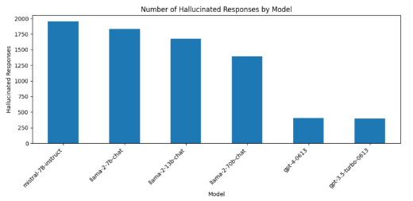
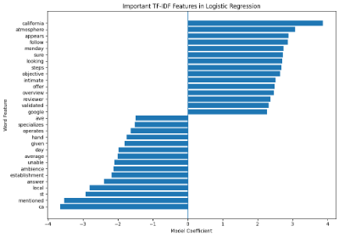
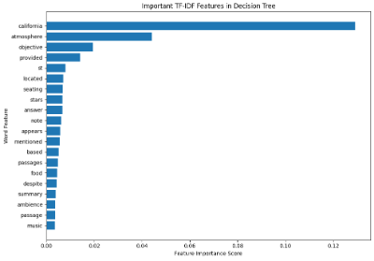
AI & Misinformation RAGTruth Modeling
Zooni Affreene, Keya Chaudhari, Javier Miramontes, and Bryce Blaylock | August 2026
Introduction
Results
Conclusion
Background:
Artificial intelligence is increasingly used in healthcare, finance, education, customer service, and other enterprise applications. However, AI systems can produce hallucinations, which are responses that sound convincing but contain unsupported or incorrect information.
Problem & Importance: AI hallucinations can spread misinformation, reduce trust in AI systems, and negatively affect decision-making. Detecting these responses is important for developing safer, more transparent, and reliable AI systems.
Research Question:
Can a single hallucination detector be deployed across different enterprise applications, or does accuracy degrade significantly by domain?
Project Goal:
Our goal was to use machine learning to classify AI-generated responses as hallucinated or factual, compare Logistic Regression and Decision Tree classifiers, and deploy the best-performing model as an interactive application.
Why It Matters:
Reliable hallucination detection can support safer AI use across high-impact applications and help users identify potentially unreliable AI-generated information.
Logistic Regression (Best Performer)
Accuracy: 74.5%
Precision: 0.76 (strong ability to correctly identify hallucinations when predicted)
Recall: 0.72 (captures most hallucinations, though misses some)
F1 Score: 0.72 (balanced performance between precision and recall)
Confusion Matrix:
Correctly identified 1815 non-hallucinations and 837 hallucinations
Misclassified 210 non-hallucinations and 696 hallucinations
-> The model is better at avoiding false positives, but it sacrifices some recall, which means it misses a portion of actual hallucinations.
Decision Tree:
Accuracy: 67.0%
Precision: 0.67
Recall: 0.67
F1 Score: 0.67
Confusion Matrix:
Correctly identified 1477 non-hallucinations and 944 hallucinations
Misclassified 548 non-hallucinations and 589 hallucinations
-> The Decision Tree is more balanced in errors but overall weaker, as it misclassifies more non-hallucinations as hallucinations, lowering precision
Key Takeaways:
Successfully built and evaluated a hallucination detection model
Logistic regression achieved the best performance
Deployed an interactive Streamlit application
- https://ai-hallucination-detector-m8ffq5xeappttirgcs23sbk.streamlit.app/
Demonstrated how AI used responsibly can improve reliability and reduce misinformation
Visualizations
Methodology
DATASET & DATA EXPLORATION
Dataset Overview
Source: RAGTruth – ParticleMedia / ACL 2024 (Newsbreak + UIUC)
Size: 17,790 responses with 9 original features, plus 1 binary target (has_hallucination)
Labels: Hallucinated, Factual
Train/Test Split: 80% Training, 20% Testing
Data Exploration: Conducting rigorous EDA to uncover core patterns:
Distribution of hallucinated vs. factual responses
Analysis of response length
Domain distribution across sources
Feature Engineering: Extracting predictive signals for model training:
TF-IDF text features
Contextual similarity score
Response length metrics
Named Entity across sources
Bibliography
Niu, C., Wu, Y., Zhu, J., Xu, S., Shum, K., Zhong, R., … Zhang, T. (n.d.). Ragtruth: A hallucination corpus for developing trustworthy retrieval-augmented language models. Retrieved from https://aclanthology.org/2024.acl-long.585/
Ji, Z., Lee, N., Frieske, R., Yu, T., Su, D., Xu, Y., … Fung, P. (2024). Survey of hallucination in natural language generation. Retrieved from https://arxiv.org/abs/2202.03629
Huang, L., Yu, W., Ma, W., Zhong, W., Feng, Z., Wang, H., … Liu, T. (2024). A survey on hallucination in large language models: Principles, taxonomy, Challenges, and open questions. Retrieved from https://arxiv.org/abs/2311.05232
Fig 1. Number of Hallucinated Responses by Model . This graph shows GPT-4 generated the fewest hallucinations
Fig 2. Logistic Regression Feature Importance. Uses coefficient weights to identify influential TF-IDF features
Machine Learning Algorithm(s) Strategy
Logistic Regression
Type: Supervised Learning | Binary Classification
Input: TF-IDF Features
Output: Hallucinated / Factual
Pros:/Cons
Fast, highly interpretable, and delivers strong baseline accuracy
Limitations: Assumes linear relationship between features
Decision Tree
Type: Supervised Learning | Binary Classification
Pros: Very easy to interpret, map visually, and explain to stakeholders
Cons: High risk of overfitting, especially with high-dimensional data
Fig 3. Decision Tree Feature Importance. Uses feature importance scores to rank influential TF-IDF features

